Slide 1
R Workshop
An introduction to the statistical programming language, R and the integrated development environment, R Studio
2016 CFAC & FOIL Conference
BY: Stephen Sutton
Manager, Research
Pinellas County Schools
suttonst@pcsb.org
(727) 588-6000 x: 1932

Slide 2
What is R?
The R statistical programming language is a free, open-source language based on the programming language, S developed by Bell Labs
The language is very powerful for writing programs
Many mathematical and statistical functions are built-in
Community contributed packages greatly expand the functionality of R
R is a tool for:
Data manipulation
Statistical modeling & Computation
Data visualization

Slide 3
Why use R?
R is open-source, and free
Anyone can inspect, change, and tinker with R’s source code
Anyone can create and publish packages to perform specific tasks not included in the base installation of R – we will see examples of this later today!
R is a language
R is an simple, intuitive, and easy-to-learn language
R allows you to write and save scripts to perform a series of tasks
Graphics and Data Visualization
R has a robust set of graphics and visualization tools built-in
Boxplots, scatterplots, bar charts, density plots, and other
Statistical Analysis
Standard data analysis tools are built-in to R
T.tests, correlations, linear & logistic regressions, ANOVAs, and many more statistical techniques can be performed using the base installation of R
Large, vibrant community
R has thousands of contributors (people writing packages, expanding the R source code) and millions of users worldwide
A collection of 1000s of publically available packages
If you have a question related to R, chances are someone on the internet has answered it

Slide 4
R Basics
Simple operations
+, -, *, /, ^ are the standard arithmetic operators in R
R is an object-oriented language
Types of objects include:
Scalars
A scalar object (or variable) contains a single element
> X = 1
> Y = 'one'
Vectors
Vectors contain a sequence of elements
X = c(1, 2, 3)
Y = c('one', 'two', 'three')
Matrices
Rows and columns of vectors , all of the same type (numeric, character, etc.)
X = matrix(1:20, nrow=5, ncol=4)
Data Frames
Very similar to matrices, except that different column can contain different variable type
When you think of the term 'data set', think 'data frame' in R
Data frames are the fundamental structure used in data analysis

Slide 5
R Basics (cont.)
Object Types/Classes
Numeric
Decimal numbers are stored as type 'numeric'
x = 5.5
Integer
Whole numbers are stored as type 'integer'
x = 2
Character
String values are stored as type 'character'
x = 'hello world'
Factors
Similar to character variables, however factors are actually numeric codes that represent different character levels
A character variable:
x = c('boy', 'boy', 'girl', 'boy', 'girl', 'girl')
A factor variable:
x = as.factor(c('boy', 'boy', 'girl', 'boy', 'girl', 'girl'))
levels(x)
Logical
Typically the result of a comparison
x = 1 ; y = 5
z = x < y
What does 'z' now equal?

Slide 6
R Basics (cont.)
Basic Arithmetic Operations
+ addition
- subtraction
* multiplication
/ division
^ to the power
Basic Logical Operations
== equality
!= not equal
& and
| or

Slide 7
R Studio
R Studio is a free and open-source integrated development environment (IDE)
Using an IDE like R Studio offers many advantages:
Real-time tracking of variables and data frames
Real-time display of graphs and visualizations
Writing and saving scripts for later use
Built-in features to allow easy

Slide 8
R Studio

Slide 9
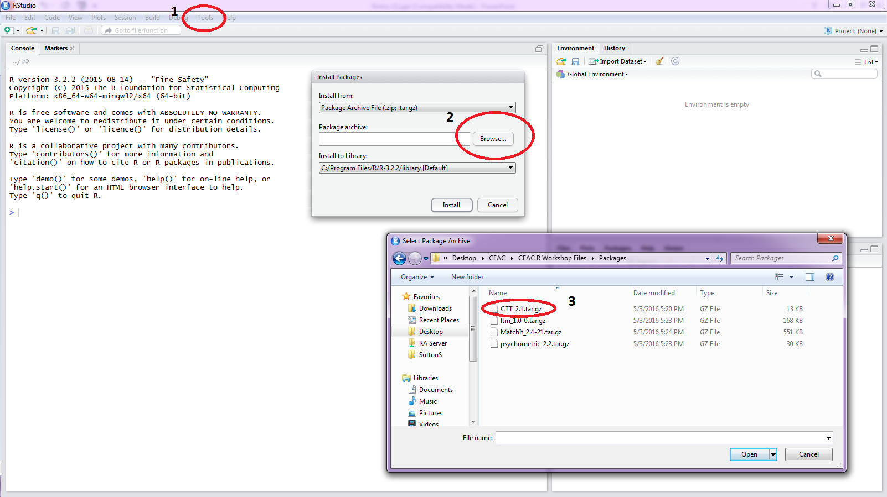
Installing Packages in R Studio

