Slide 1

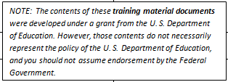
Central Florida
Assessment Collaborative
Item Writer & Reviewer Training

Slide 2
Agenda
CFAC Website, Sharepoint Site, and Franzipanics Overview
Overview of Development Process
Item Process, Types, and Format
Cognitive Complexity

Slide 3
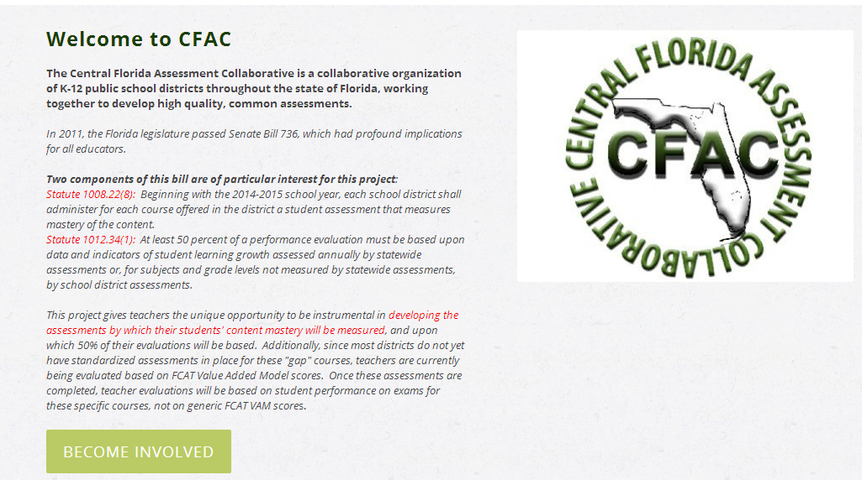
CFAC website
www.cfacteam.weebly.com
Notes:
Go to CFAC website, show how to use, and have participants download and save presentation.

Slide 4
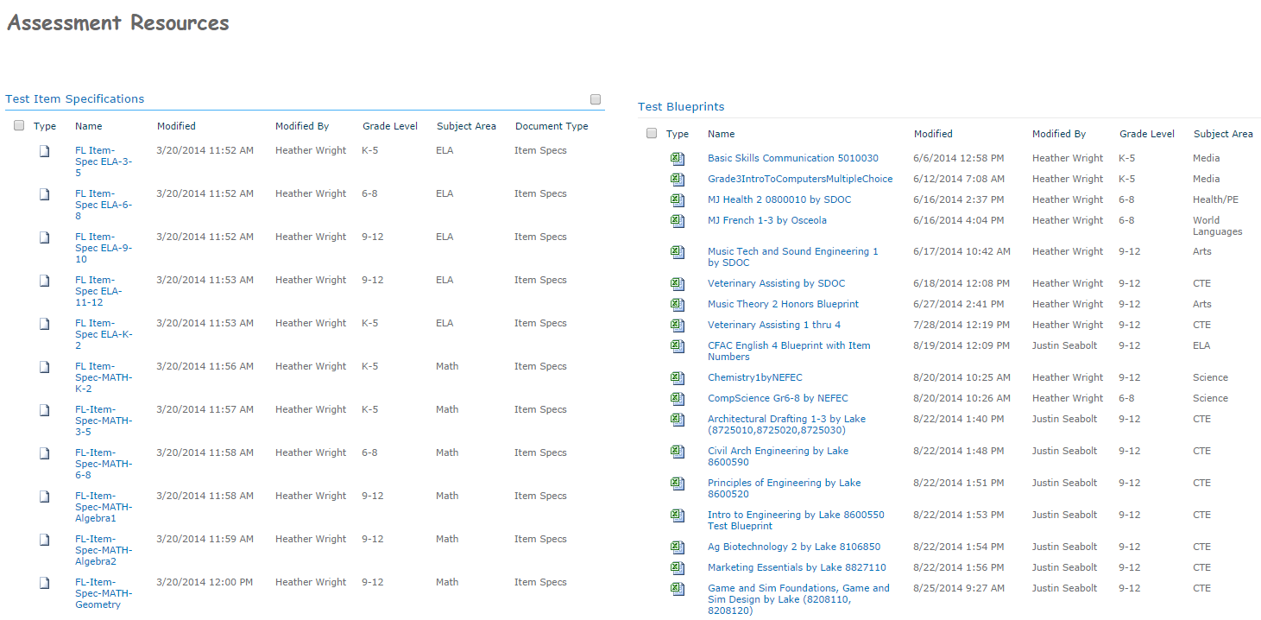
Sharepoint Site
http://sp.osceola.k12.fl.us/Depts/REA/Assessments/SitePages/Home.aspx
Notes:
For Justin’s Gap Courses

Slide 5
Franzipanics
Take the test here: https://www.surveymonkey.com/s/83NKRJZ
The answer? Are there answers? Why is this test predictable?

Slide 6
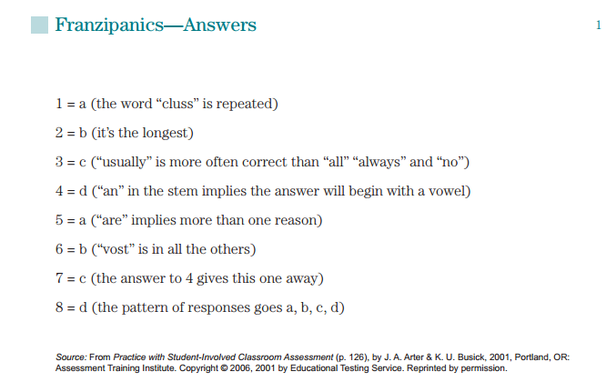
Franzipanic “Answers”

Slide 7
Overview of
Assessment Development Process
Steps in Test Development
Test Design
Item Specifications
Item Writing

Slide 8
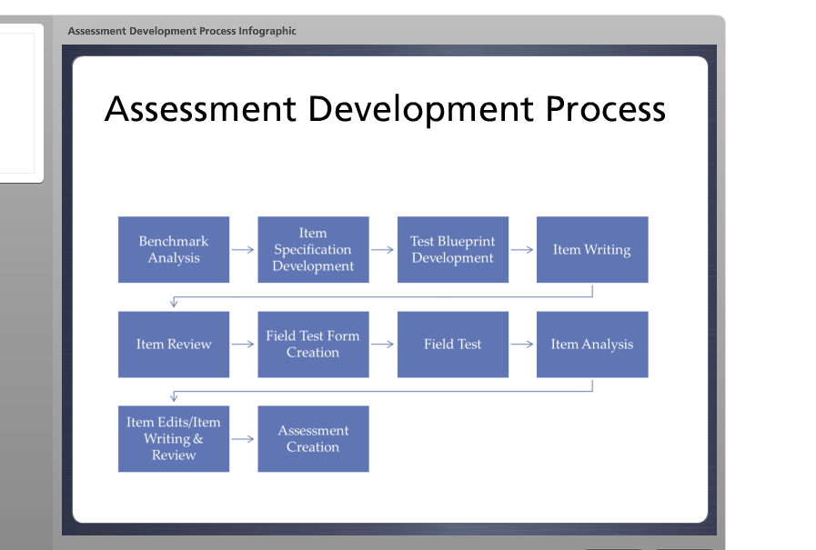
www.cpalms.org
Notes:
Go to Cpalms
Mention that if you are an Osceola teacher working with Justin on Gap Courses, then it goes straight from benchmark analysis to test blueprint development. But it’s a modified test blueprint that contains parts of what would be included in a full blown item spec document but not everything.

Slide 9
Steps for Assessment Development
Item Specifications
Standard
Benchmark
Depth of Knowledge
Item Types
Content Limits
Stimulus Attributes
Response Attributes
Sample Item
Notes:
Show example of core & cte item spec

Slide 10
Steps for Assessment Development
Test Blueprint
Sets the parameters for the test and the items – the Blueprint
Determines which benchmarks are evaluated at what cognitive complexity level
Determines item format
  Multiple-choice items will be 4-option
Determines item difficulty and Cognitive Complexity for individual test items.
Notes:
Show example of blueprint – What is diff between difficulty and complexity?

Slide 11
Steps for Assessment Development
Item Writing
Uses the course description and item specifications document to create items
Items are written to cognitive complexity levels that the benchmark/standard warrants
Items are written to align with the item specifications
Items are written according to ‘good item writing rules’

Slide 12
Steps for Assessment Development
Item Review
Were the Item Writing Guidelines followed?
Is the item free of bias and sensitivity issues?
Does the item appear to measure what’s specified in the item spec?
Is item truly appropriate for the students taking the course?
Is the language complexity appropriate for this course?
Has correct grammar and punctuation been used in the construction?
Is accurate scoring information included?
Is there alignment with the complexity of the standard?
Notes:
Item Writer and Reviewer Checklist
Personal Item Writing and Reviewing Tracking Sheet
Multiple Choice Answer Choice Guidelines

Slide 13
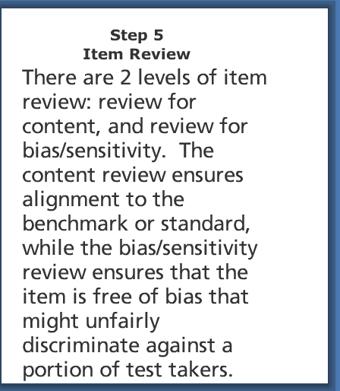
Note
There are three levels of review in Equella (grant courses) and two levels of review in Eduphoria (non-grant). We will discuss these differences later.

Slide 14
Item Types

Slide 15
Possible Item Types
Selected Response Items:
  Multiple Choice Items
Constructed Response Items:
  Gridded Response Items/Fill-In Response Items
  Short-Answer Items
  Extended Response Items
  Performance Task
  Audio Response (WL Only)
  Video Response (WL Only)

Slide 16
Formatting a Selected Response Question
Must be in the form of a question.
All answer choices must be alphabetical order (words/short phrases) or shortest to longest (long phrases/sentences).
Any words of importance should be lower case, bold.
Answer choices should not include an absolute or definitive. (always, never, everything but, all of the above)
Ex. Which of the following is a comparison of two unlike things using the terms “like” or “as”?
A.) allusion
B.) metaphor
C.) personification
D.) simile

Slide 17
Multiple Choice Items
What does 3 + 2 equal?
    1
    5
    6
    32
1-point value
The Stem
Distractor
CORRECT
ANSWER
Distractor
Distractor
Distractor’s must be written in a manner which COULD be true. When writing distractor’s, you are required to provide a rationale for why a student may choose this as an answer. In this example, why may a student choose A, C, or D?

Slide 18
Example
If a test is extremely easy for a given group, we would expect:
The reliability to be moderate
The reliability to be high
The reliability to be unaffected by this
The reliability to be low
All of the above
What’s the issue?
How could the item be modified?

Slide 19
Example
If a test is extremely easy for a given group, we would expect:
The reliability to be moderate
The reliability to be high
The reliability to be unaffected by this
The reliability to be low
All of the above
MC questions must be in the form of a question
MC questions can only have 4 answer choices
Answer choices not in correct order
Answer choices are not stylistically correct

Slide 20
Constructed Response Item Types
Gridded Response/Fill-In Response
Short Answer
Extended Response
Video Response (World Language only)
Audio Response (World Languages only)
Performance Assessments
  On Demand
  Portfolio-based

Slide 21
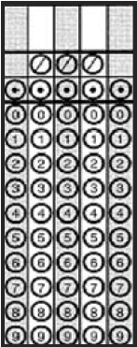
Gridded Response/Fill-In Response Items
Problems or questions requiring a numerical response for students to bubble or mark answers into response grids
Gridded Response items must also be in the form of a question
1-point value

Slide 22
Short Answer Items
Written so that the item can be answered with a number, symbol, word, brief phrase or 1 to 3 sentences
Should ask for 2 actions from the student, ideally
Graded using a 3-point Scoring Guideline with scores of 0, 1, and 2
Take approximately 2 to 5 minutes per item to answer
Do not have to be in the form of a question
0-2 point value

Slide 23
Short Answer Sample Question
Scenario: In a study on body language, a researcher has participants come in for an interview. Each participant is seated across from the interviewer and is asked 10 questions. In half the interviews the interviewer leans back in his chair. In the other half of the interviews, the interviewer leans forward in his chair. Each interview is recorded so the length of each participant’s answer (number of words spoken) can be measured.
What is the independent variable from this study?
What is the dependent variable from this study?
Notes:
In this sample item, students are given a scenario and are asked to identify two variables from the study, the independent variable and the dependent variable. Notice that this item is written as a question, and that it asks the students to do two things. Separating the question prompt into two separate questions might be helpful to students, who might otherwise just read and pay attention to the first part of a two-part question.

Slide 24
Short Answer Question Continued
Sample full-credit response:
  Independent variable: interviewer’s body language
  Dependent variable: length of the response
Sample scoring rubric:
  2 points – The student identifies the correct independent variable AND the correct dependent variable.
  1 points – The student correctly identifies either the independent variable OR the dependent variable.
  0 points – The student fails to identify correctly the independent and the dependent variables.
Notes:
As you can see here, a sample scoring rubric for the previous question can be written very simply. Either the student correctly identifies the independent AND dependent variables for 2 points, or correctly identifies the independent OR dependent variable for 1 point, or correctly identifies neither. With a scoring rubric such as this, interrater reliability, the degree to which the scorers agree, would be very high because this is a very clear-cut, objective rubric. The sample full-credit response is simply there to give the scorers an example of the minimum that a student must do in order to earn full credit. Notice that the prompt did not require students to answer with a full sentence, so our sample response gave an example of a sentence fragment. We provide a MINIMUM full-credit response so that scorers do not get confused and believe that a student must provide complete sentences in order to earn full credit. This is not always the case – if the prompt were to ask students to write their response in a complete sentence, then that would be one of the things indicated in the scoring rubric as needing to be completed in order to earn full credit. If it is in the scoring rubric, though, we must be sure that it is clear to the students that this expectation exists. In other words, our questions must align with our rubric.

Slide 25
Example
SS.6.W.2.1: Compare the lifestyles of hunter-gatherers with those of settlers of early agricultural communities.
Item: What are two ways the communities of hunter-gatherers are different from the communities of farmers?
Notes:
Take a moment and read the following sample item, taken from a grade 6 social studies class. [narrator pause] Note that it asks for two things from the student: Two differences between the communities of hunter-gatherers and the communities of farmers.

Slide 26
2 Point Rubric
2 | A score of two indicates that the student has demonstrated a thorough understanding of the social studies concepts applicable to the prompt. The student has provided a complete and correct response to all parts of the prompt. When required, student explanations are clear and complete. The response may contain minor flaws that do not detract from the demonstration of a thorough understanding.
1 | A score of one indicates that the student has demonstrated an incomplete understanding of the social studies concepts applicable to the prompt or has provided a response that is only partially correct. The student may have arrived at an acceptable conclusion, but with a flawed or weak application of social studies concepts. The student may also have applied the social studies concepts but failed to fully arrive at the conclusion. The response may contain flaws that detract slightly from the demonstration of understanding.
Notes:
This writer used a general scoring rubric. Take a moment and read the descriptions of a 2 point and 1 point score. [narrator pause]

Slide 27
2 Point Rubric
0 | A score of zero indicates that the student has not provided a response or has provided a response that does not demonstrate an understanding of the social studies concepts applicable to the prompt. The student’s explanation may be uninterpretable, lack sufficient information to determine the student’s understanding, or contain clear misunderstandings of the underlying social studies concepts. The response may contain major flaws that detract from the demonstration of understanding.
Notes:
Here is an example of a 0 point score. Take a moment to read over this general rubric. [narrator pause]

Slide 28
Minimum Full Credit Sample Response
Score | Description
2 | The hunter-gatherers went from place to place in groups, while the farming families lived in villages. The hunter-gatherers moved to find and hunt food. They left when the food supply was gone. The farming communities stayed in one place and planted their own food instead of looking for it.
Notes:
Here is the sample student response provided by the item writer. Note that this response is written in a voice similar to that of a 6th grade student, and contains the minimum amount of information required to earn the full 2 points: Two ways that the hunter-gatherers were different from the farming communities.

Slide 29
Example Student Response
“Hunter-gatherers moved around while farmers stayed in one place. Farmers grew and raised their food while hunter-gatherers had to find it or hunt it.”
Notes:
Let’s try scoring a few student items, using the rubric provided. Take a moment and read this item. What score would you give this student? [narrator pause then click] By providing two ways the groups are different (Hunter-gatherers moved around while farmers stayed in one place. Farmers grew and raised their food while hunter-gatherers had to find it or hunt it.), this response demonstrates a thorough understanding of the social studies concepts applicable to the prompt. This student would earn 2 points using our scoring rubric.

Slide 30
Example Student Response
“Hunter-gatherers moved around while farmers stayed in one place. Farmers grew and raised their food while hunter-gatherers had to find it or hunt it.”
Score of 2
Notes:
Let’s try scoring a few student items, using the rubric provided. Take a moment and read this item. What score would you give this student? [narrator pause then click] By providing two ways the groups are different (Hunter-gatherers moved around while farmers stayed in one place. Farmers grew and raised their food while hunter-gatherers had to find it or hunt it.), this response demonstrates a thorough understanding of the social studies concepts applicable to the prompt. This student would earn 2 points using our scoring rubric.

Slide 31
Example Student Response
“Farmers lived in one place while hunter-gatherers moved from place to place. Since farmers lived in one place, they sometimes worked together while hunter-gatherers usually worked by themselves.”
Notes:
How about this one? [narrator pause then click] This response demonstrates an incomplete understanding of the social studies concepts applicable to the prompt because it is only partially correct. While the student provides two ways the communities are different; only one is correct (Farmers lived in one place while hunter-gatherers moved from place to place). The other idea presented is inaccurate (Since farmers lived in one place, they sometimes worked together while hunter-gatherers usually worked by themselves). Thus, this student only receives partial credit.

Slide 32
Example Student Response
Score of 1
“Farmers lived in one place while hunter-gatherers moved from place to place. Since farmers lived in one place, they sometimes worked together while hunter-gatherers usually worked by themselves.”
Notes:
How about this one? [narrator pause then click] This response demonstrates an incomplete understanding of the social studies concepts applicable to the prompt because it is only partially correct. While the student provides two ways the communities are different; only one is correct (Farmers lived in one place while hunter-gatherers moved from place to place). The other idea presented is inaccurate (Since farmers lived in one place, they sometimes worked together while hunter-gatherers usually worked by themselves). Thus, this student only receives partial credit.

Slide 33
Example Student Response
“Hunter-gatherers had to search for their food while farmers planted and harvested their food.”
Notes:
Let’s look at another student response. [narrator pause, then click]. This response demonstrates an incomplete understanding of the social studies concepts applicable to the prompt because only one acceptable difference is provided (Hunter-gatherers had to search for their food while farmers planted and harvested their food.).

Slide 34
Example Student Response
Score of 1
“Hunter-gatherers had to search for their food while farmers planted and harvested their food.”
Notes:
Let’s look at another student response. [narrator pause, then click]. This response demonstrates an incomplete understanding of the social studies concepts applicable to the prompt because only one acceptable difference is provided (Hunter-gatherers had to search for their food while farmers planted and harvested their food.).

Slide 35
Example Student Response
“Farmers would of had more money than hunters-gatherers because they would of owned more things.”
Notes:
What score would you give this student response? [narrator pause then click] The response does not demonstrate an understanding of the social studies concepts applicable to the prompt. The student’s response lacks sufficient information to determine the student’s understanding, so the student receives no credit.
Notice how, with a well-written item, the students are clear on their expectations, and the scorers are clear on how to score the item equitably and consistently. Because our test items will be used across multiple districts, and will be scored by teachers with a variety of backgrounds and educational experiences, the items and scoring rubrics need to clearly convey expectations to students and teachers.

Slide 36
Example Student Response
Score of 0
“Farmers would of had more money than hunters-gatherers because they would of owned more things.”
Notes:
What score would you give this student response? [narrator pause then click] The response does not demonstrate an understanding of the social studies concepts applicable to the prompt. The student’s response lacks sufficient information to determine the student’s understanding, so the student receives no credit.
Notice how, with a well-written item, the students are clear on their expectations, and the scorers are clear on how to score the item equitably and consistently. Because our test items will be used across multiple districts, and will be scored by teachers with a variety of backgrounds and educational experiences, the items and scoring rubrics need to clearly convey expectations to students and teachers.

Slide 37
Extended-Response Items
Students respond to items in their own words
Open-ended response format
One or more paragraph (lengthy) response
Response time should be approximately 10-20 minutes
Rubric must be provided for scorers (uses 5 point scoring guideline ranging from 0-4)
Notes:
In contrast to short-answer items, extended response items are open-ended and should require one or more paragraphs for the student to correctly respond. Students will respond to items in their own words and response time should be approximately 10-20 minutes. Item writers must also provide a rubric for scorers. We will talk in greater detail later in this course about developing scoring rubrics and ensuring alignment of items to rubrics.

Slide 38
Extended Response Sample Question
Stimulus: During a flag football game in class, a student on the defense realized the offense was taking advantage of a weak middle of the field. The student’s goal was to place more players in coverage to counteract this offensive approach. Identify an appropriate defensive strategy that the team should use and justify why you feel that the selected strategy would benefit the defense. Explain your reasoning and then diagram the set-up on the field.
Notes:
Here is a sample extended response question from a physical education class. This is a 4-point question, and note that there are 4 actions that the students are asked to take:
Identify an appropriate defensive strategy
Justify why that strategy would be beneficial
Explain their reasoning
Diagram the set-up on the field
A sample rubric could break up each of these four to be worth 1 point, so that, for full credit, the student would correctly complete all 4 steps. For 3 points, the student would correctly complete 3 of the 4 steps, etc.

Slide 39
Extended Response Sample Question - Scoring Guidelines
4 Points The response identifies one advanced defensive strategy that can be applied to the given scenario. The response explains and justifies why the defensive strategy should be used. The response accurately illustrates the proper placement of individuals on the diagram.
3 Points The response identifies one advanced defensive strategy that may be applied to the given scenario. The response explains and justifies why the defensive strategy should be used, but may not apply it to the given situation. The response attempts to illustrate the placement of individuals on the diagram.
2 Points The response identifies one defensive strategy that may not be applied to the given scenario. The response explains and justifies why the defensive strategy should be used, but the explanation may be incomplete. The diagram on the field may not match the defensive strategy explained.
1 Point The response does not identify any defensive strategy or describes an inappropriate strategy. The response does not explain or properly justify why the defensive strategy should be used. There may be no explanation or no diagram.
0 Points The response is incomplete, may exhibit many flaws, and may not address all requirements of the task.

Slide 40
Scoring Guidelines
Scoring guides used to assess and score complex or lengthy responses
Consist of a set of criteria that state the critical elements that the response must contain
Contain a set of ordered categories with descriptions to which student responses can be compared in order to assign a score
Clear and distinct levels of achievement, while still allowing for a variety of possible correct responses at that level
Notes:
Constructed Response Rubric Template

Slide 41
Performance Based items
Require students to
  produce a product
  demonstrate a process
  solve a problem involving several steps
  carry out an activity that demonstrates proficiency with a complex skill.
Two types:
  On-demand Performance – obtained at the time of the assessment
  Portfolio-based Performance – a previously developed piece refined over time that is included as part of the assessment.
Notes:
Performance Based Test Item Example

Slide 42
Other Item Types: World Languages
Audio Response:
  Not to exceed 60 seconds
  Proficiency-level appropriate
  Requires a microphone
  May include media in the stimulus and/or response
Video Response:
  Not to exceed 60 seconds
  Proficiency-level appropriate
  Requires webcam
  May include media in the stimulus and/or response
Notes:
Because of the heavy emphasis on communication, world languages has two additional types of items that could be included on an assessment. As you can see, because of equipment requirements, these types of items only lend themselves to computer-based administrations.

Slide 43
Cognitive Complexity
Notes:
In this module, we will cover cognitive complexity levels, which, in Florida, uses Norman Webb’s Depth of Knowledge, also referred to as D.O.K.

Slide 44
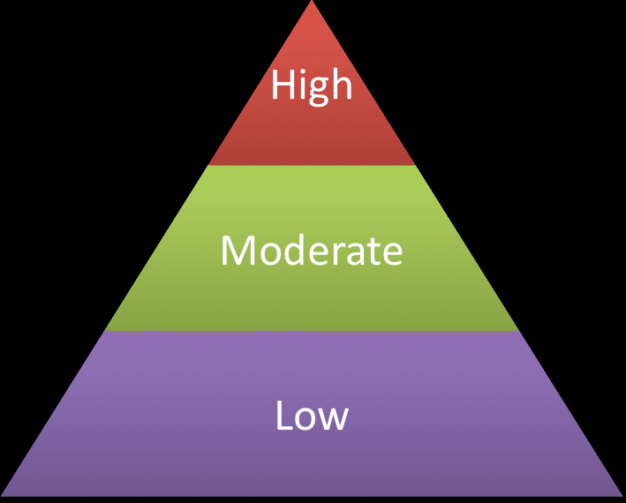
Florida DOK Framework
The Florida DOK framework is comprised of three categories.
high complexity (levels 3 & 4)
moderate complexity (level 2)
low complexity (level 1)
Levels 3-4
Level 2
Level 1
Notes:
Webb’s DOK Wheel

Slide 45
Sample Item 1
This photograph of clouds was taken from an airplane. What type of cloud is pictured in the lower half of the photograph?
Notes:
Look at this sample item. What cognitive complexity level do you think it is? [Narrator pause]. [Narrator click] If you said low complexity, that is correct. This is a simple recall item, requiring students to look at the photograph and identify the cloud type. This is a concrete question, with a context identical to that used during instruction – students are shown photos of different cloud types.

Slide 46
Sample Item 1
Level 1: Low Complexity
This photograph of clouds was taken from an airplane. What type of cloud is pictured in the lower half of the photograph?
Notes:
Look at this sample item. What cognitive complexity level do you think it is? [Narrator pause]. [Narrator click] If you said low complexity, that is correct. This is a simple recall item, requiring students to look at the photograph and identify the cloud type. This is a concrete question, with a context identical to that used during instruction – students are shown photos of different cloud types.

Slide 47
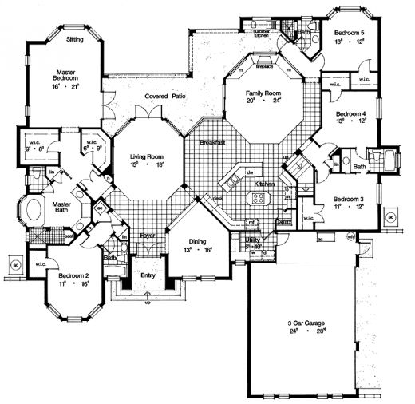
Sample Item 2
Develop plans for modifying this large residential home into a bed-and-breakfast lodging facility.
Notes:
Let’s try another example item. What cognitive complexity level do you think this is? [Narrator pause & then click after pause]. If you said High Complexity, you were correct. This item requires students to use their knowledge of drafting, while making decisions about structural changes that need to be made in order to convert the floor plan from a residential home into a bed-and-breakfast. It is abstract, in that students need to think about the design needs of one type of facility, compared to another, and then translate the floor plan accordingly.

Slide 48
Sample Item 2
Level 3: High Complexity
Develop plans for modifying this large residential home into a bed-and-breakfast lodging facility.
Notes:
Let’s try another example item. What cognitive complexity level do you think this is? [Narrator pause & then click after pause]. If you said High Complexity, you were correct. This item requires students to use their knowledge of drafting, while making decisions about structural changes that need to be made in order to convert the floor plan from a residential home into a bed-and-breakfast. It is abstract, in that students need to think about the design needs of one type of facility, compared to another, and then translate the floor plan accordingly.

Slide 49

Sample Item 3
The measuring cup shown here will be filled half-full with water, and then the irregularly shaped rock will be placed in the cup. How does this allow one to measure the volume of this rock?
Notes:
Here is our final example. What cognitive complexity level do you think this is? [Narrator pause, then click] In this case, the type of information involved is the PRINCIPLE related to the rock displacing water equivalent to the volume of the rock. This illustration is probably similar to illustrations used during instruction, thus the context is similar or parallel to instruction. This is a moderate complexity item.

Slide 50
Sample Item 3
Level 2: Moderate Complexity
The measuring cup shown here will be filled half-full with water, and then the irregularly shaped rock will be placed in the cup. How does this allow one to measure the volume of this rock?
Notes:
Here is our final example. What cognitive complexity level do you think this is? [Narrator pause, then click] In this case, the type of information involved is the PRINCIPLE related to the rock displacing water equivalent to the volume of the rock. This illustration is probably similar to illustrations used during instruction, thus the context is similar or parallel to instruction. This is a moderate complexity item.

Slide 51
Homework
Short Answer Assignment
Rewrite MC/SA to increase the complexity. Include rubric and sample response for what student would need to have (at minimum) to earn full credit.
Multiple Choice Assignment
Rewrite MC item to increase the complexity. Indicate complexity of original and revised question. Follow all conventions and guidelines. Provide rationales for your distractors as well for the revised question only.
**Place both parts in the same document and name the file as “Name Revised Questions Date”
Email assignment to kigosmar@Osceola.k12.fl.us

Slide 52
Paperwork
Paperwork should be scanned and emailed to Carlos Caban at cabancar@Osceola.k12.fl.us or faxed to 407-970-4952
All paperwork can be found at http://cfacteam.weebly.com/invoice-information--pre-employment-paperwork.html

Slide 53
Agenda
Cognitive Complexity vs. Difficulty Level
Bias and Sensitivity
Finding Copyright-Free or Commercial Use Images and Passages
Grant vs Non-Grant

Slide 54
Cognitive Complexity vs. Item Difficulty
Notes:
In this module, we will cover the differences between cognitive complexity and difficulty, two concepts which people often confuse.

Slide 55
Item Difficulty
Easy = More than 70% answered correctly
Average = Between 40% and 70% answered correctly
Challenging = Less than 40% answered correctly
Notes:
Item difficulty is entirely determined by the percent of students who are likely to answer a question correctly. Easy items are those which more than 70% of students are likely to answer correctly. Average items have a student success rate of between 40% and 70%. And challenging items are those which fewer than 40% of students are likely to answer correctly.

Slide 56
Complexity vs. Difficulty
What is 4 + 4?
  Low Complexity
  Easy Difficulty
What is 4,505,358 + 2,552,622?
  Low Complexity
  Challenging Difficulty
Item Difficulty = based on the percent of students likely to respond correctly to an item
Cognitive Complexity (Depth of Knowledge) = refers to the complexity of the mental processing that the student must use to answer the item, not the difficulty of the item.
Notes:
In contrast to difficulty, which is based on the percent of students likely to respond correctly to an item, cognitive complexity (Depth of Knowledge) refers to the complexity of the mental processing that the student must use to answer the item, not the difficulty of the item. In this example problem, the student has learned the rules of addition, and is given two problems. The first problem [click] is easy, since more than 70% of students could be expected to get this correct, and it is low complexity, since it requires simple application of a rule. The second problem [click] is difficult, since fewer early elementary students would answer this item correctly. However, it is still a low complexity item, since it also requires simple application of a rule.

Slide 57
Example
What does the word illeist mean?
refers to themselves in the 3rd person.
plays a specialized musical instrument.
is sick.
loves animals.
Difficulty?
DOK?
Notes:
Take a minute to read over this item. [pause] What is its level of difficulty? How about its Depth of Knowledge? If you said the level of difficulty was challenging, you are correct. This item is at level 1 depth of knowledge, low cognitive complexity, since it requires simple recall.
Audience is 10th Grade Biology Class

Slide 58
Example
What does the word illeist mean?
refers to themselves in the 3rd person.
plays a specialized musical instrument.
is sick.
loves animals.
This item is at level 1 depth of knowledge, low cognitive complexity, since it requires simple recall.

Slide 59

Bias and Sensitivity

Slide 60
Bias & Sensitivity
“A bias and sensitivity review helps to ensure that items and stimuli are free of bias and do not exclude any group of children from demonstrating what they know and are able to do.”
Notes:
When developing tests, we don’t want for our test items to discriminate against or unfairly disadvantage a particular set of students. Well written items measure what students know, not gender, racial, or socioeconomic characteristics of the students. For our project, every item goes through a bias and sensitivity review by a teacher who has ESE certification, ESOL certification, or, preferably, both certifications, as well as experience with special populations of students. Whether you are an item writer or reviewer, becoming familiar with the principles of a bias and sensitivity review will help ensure high quality test items. Please refer to and use the Bias and Sensitivity Guide provided as a resource in this module, to ensure that your items are in alignment with Florida’s expectations.

Slide 61
Bias
Students should not be at an advantage or disadvantage based on their personal characteristics.
Personal characteristics:
  Gender
  Race/Ethnicity
  Religion
  SES
  Geographic Region
  Experience
Notes:
The fundamental principle behind bias review of items is that students who are taking the test should not be at an advantage or disadvantage based on their personal characteristics. These characteristics include gender, race or ethnicity, religion, socioeconomic status, geographic region, and personal experiences. When you are developing items for these assessments, remember that they will be used throughout Florida. One of the most common problems with bias is having items that discriminate by geographic region. A recent item on a Florida assessment contained a passage that described a child going camping in the mountains with his grandfather, who played a banjo. While this scenario is one that most reviewers could immediately recognize as being outside of the realm of experience for the majority of Florida’s students, there are other items that are less clear-cut, because they may refer to something that is commonplace in one region of Florida but not in another. Be sensitive to regional considerations as you are writing and reviewing items.

Slide 62
Bias: Examples
Portrayal of leisure activities that are not accessible to all children
Balance of gender and ethnicities in names
Stereotyping any groups
Over-inclusion or under-inclusion of any group
Notes:
Here are a few examples, taken from the Bias and Sensitivity guide, for things to be aware of when writing and reviewing items. Because the majority of our teacher item writers are members of the middle class, sometimes item writers refer to activities that are not accessible to lower
Another consideration is the names that are used in passages or question stems. As a writer, please try to include names from a variety of ethnicities, with an equal balance for gender. Avoid writing questions or passages that contain names primarily from one ethnic group or gender. And, be sensitive to perceived stereotypes as you are writing items.

Slide 63
Sensitivity
Is the subject matter acceptable to Florida students, parents, and other community members?
NOT related to student success; more tuned in to student/parent reaction to content and context.
Moralistic issues, political positions, sexuality, etc.
Notes:
In contrast to bias, sensitivity deal with whether the subject matter is acceptable to Florida students, parents, and community members. While items dealing with sensitive issues are not necessarily directly related to student success on the item, they may have an impact on students’ overall test taking because of the emotions raised by the item. For example, including an item on a state test in Louisiana that mentions Hurricane Katrina would likely be upsetting to students and may affect their ability to concentrate appropriately on the test items. Because of that, please avoid sensitive issues when writing items, unless there is a logical reason that this topic should be assessed in that content area.

Slide 64
Sensitivity Topics List (Partial)
Violence
Criminal Activities
Drugs (illegal, prescription, alcohol, tobacco) and individuals associated with drugs or controlled substances
Junk Food
Height/Weight
Dieting, other concerns about self-image
Child Abuse/Neglect
Guns/Gun Control
Suicide
Animals, Animal Bones, Animal Rights
Creationism
Family Conflict
Running Away
Notes:
Show Bias and Sensitivity Guide

Slide 65
Finding Copyright-Free or Commercial Use Images and Passages

Slide 66
Creative Commons, Copyright-Free, & Fair Use
Creative Commons (Commercial Use) – Owner must be attributed, using APA format
Copyright Free (Public Domain) – No need to attribute ownership
Copyrighted item with permission from owner – Owner must be attributed, using APA format
Student work with permission from the student and parent (if student is a minor) – Do not attribute ownership
Please indicate in the Keywords or Notes what licensing rules apply (and citation if necessary)
Notes:
How to Cite Sources Document

Slide 67
Grant vs. Non-Grant
Policies, Processes, & Procedures

Slide 68
Signing Up to Write Items
Google Drive – Item Writer Sign Up Form
Website: www.drive.google.com
**Must have a Gmail Account to use the Item Writer Signup
If you were invited to this training by Justin, email Justin Seabolt
@ seaboltj@osceola.k12.fl.us with your Gmail Account & Content Area.
If you were invited to this training by me (Marie), email me at kigosmar@Osceola.k12.fl.us
with your Gmail Account and Content Area.

Slide 69
Getting Paid
If you are working on grant courses, you will get a purchase order from Carlos Caban.
Note: Vendor paperwork must be filed before purchase orders
can be created. Email to Carlos Caban at cabancar@Osceola.k12.fl.us
or fax to 407-870-4952.
Note: Please do not complete any work until you receive notification from Carlos
or me that your purchase order is in process.

Slide 70
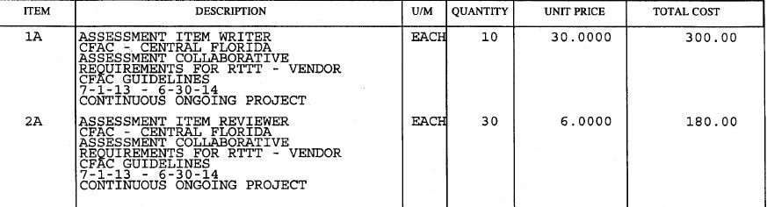
Purchase Order and Payments (Grant)
Note: The Item Writer line item and Item Reviewer line item
are independent of each other.
Note: You are responsible for monitoring the number of items written and reviewed.

Slide 71
Non-Grant (District Funded) Courses
Please contact your district representative for authorization before working on any
non-grant/district funded courses.
Contact the Grant Project Manager, Marie Kigos
at kigosmar@Osceola.k12.fl.us for
information regarding your district
representative.

Slide 72
Gap Courses (Justin’s Project)
If you were contacted by Justin regarding this training, he will be providing OPS contracts
to you for item writing and reviewing. You should contact him directly regarding this. You
email Justin @ seaboltj@Osceola.k12.fl.us.

Slide 73
Equella (IBTP) vs. Eduphoria
Notes:
Discuss how-to-guides

Slide 74
Item Writer/Reviewer Post-Test
Please click on the following link and take the required Item Writer/Reviewer Post-Test
https://www.surveymonkey.com/s/RBFMK5Z

Slide 75
Surveys
http://www.surveymonkey.com/s/GBMD9WC (Grant Only)
http://www.surveymonkey.com/s/BDFKD3B (Grant Only)
https://www.surveymonkey.com/s/writertraining

Slide 76
Any Questions?
Marie Kigos – Grant Project Manager
kigosmar@osceola.k12.fl.us
407-870-4056
Carlos Caban – Grant Project Assistant
cabancar@osceola.k12.fl.us
Phone: 407-870-4932
Fax: 407-870-4952
Justin Seabolt – Instructional Research & Evaluation Specialist
seaboltj@osceola.k12.fl.us
407-870-4924
Heather Wright – Instructional Research & Evaluation Specialist / CFAC Chair
wrighth@osceola.k12.fl.us
407-518-2903
CFAC Website: www.cfacteam.weebly.com

